Slide 1
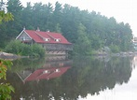
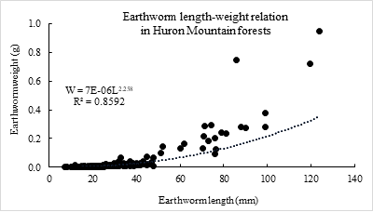
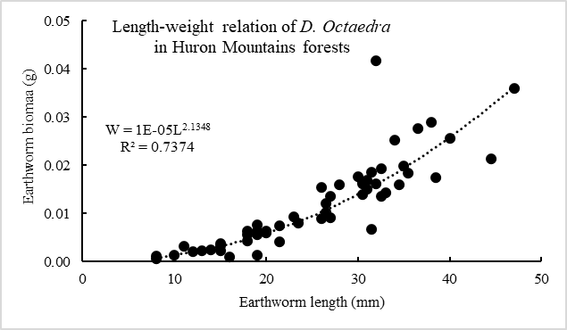
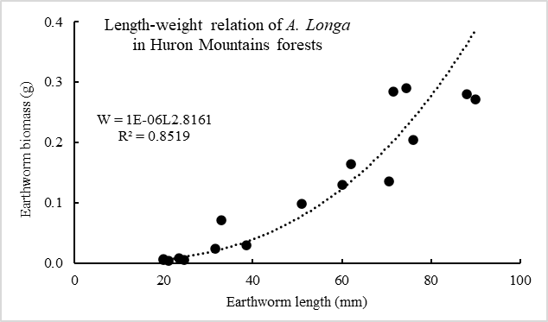
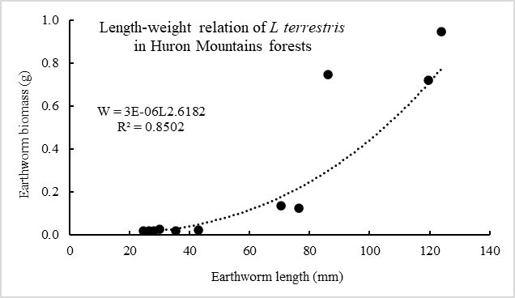
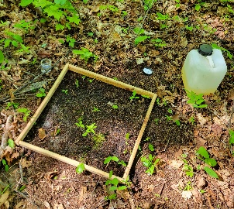
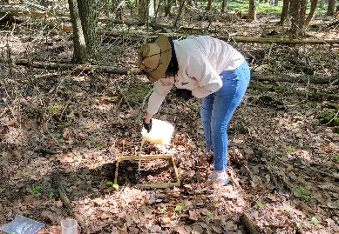
Body dimension and length-weight relationships of invasive exotic earthworm species in Huron Mountains forests
Paula Arroyo, Xiaoyong Chen, Timothy Gsell, John Yunger, Mary Carrington
Biology Program, College of Arts & Sciences
Governors State University, University Park, IL 60484
Introduction
The last Ice Age wiped out all the native earthworms 10,000 years ago, but recently earthworms have reinvaded the region due to human activity [1,2]. Invasive exotic earthworms have undesired ecological effects on structure, function and biodiversity of forest ecosystems in Great Lakes area. The biological parameters such as body length, weight, growth rate, and regeneration patterns of the earthworms are important and necessary to know for better understanding of their life cycle and their impacts on ecological processes such as nutrient biogeochemistry cycling and carbon sequestration in the forests, as well as for forest management practices
The objective of this study was to survey and identify earthworm species, body length, and dry weight in the various Huron Mountain forests.
Figure 4 Relationships of earthworm biomass and earthworm length in different forest types in the study area.
Results & Discussion (Con’t)
Dominant earthworm species in the Huron Mountains were Dendrobaena octaedra, Aporretodea longa, and Lumbricus terrestris (table 1).
L. terrestris were, on average, the largest in body mass with a mean length and dry weight of 60.4 mm and 0.254g, respectively. Average body dimension of A. longa was 50.3mm long and 0.118g. D. octaedra had the smallest average body dimension of 25.5 mm long and 0.012g.
The regression equation of body length-dry weight relationship for total earthworms was W = 0.000007L^{2.258}. Specifically, the length-weight relations were W = 0.00001L^{2.135}, W = 0.000001L^{2.816}, and W = 0.000003L^{2.618} for D. octaedra, A. longa and L. terrestris, respectively.
There is a strong exponential relationship between the earthworms' dry weight and body length (Fig.2-Fig 4).
Findings from this study suggests that variations of composition, biological features, and micro-environmental conditions in selected forests are responsible for these differentiations of earthworm features.
Results & Discussion
Table 1: Characteristics of body dimensions of three common invasive exotic earthworms in the Huron Mountains forests
 | D. octaedra | A. longa | L. terrestris
Body length (mm) | 25.47 ± 9.33 | 50.32 ± 24.50 | 60.36 ± 35.53
Length range (mm) | 8 – 44.5 | 20 - 90 | 24.5 – 119.5
Dry weight (g) | 0.012 ± 0.009 | 0.118 ± 0.108 | 0.254 ± 0.344
Weight range (g) | 0.001 – 0.042 | 0.004 – 0.291 | 0.017 – 0.948
Methods
The study was conducted within the Huron Mountains located northwest of Marquette county in the Upper Peninsula, Michigan, USA. Four inland lakes were chosen as study sites: Pine Lake, Second Pine lake, Rush Lake, and Mountain Lake. The fieldwork was carried out June of 2022 and October 2022.
Three 0.5m × 0.5m quadrats were set up in each forest type to collect earthworms. Earthworms were captured from the quadrates by using a mustard solution extraction method. Each earthworm captured was identified to species, measured in length, and its dry weight was determined by putting the earthworm in an oven for drying at 65 ⁰C for 48 hrs.
Fig. 1. Body length-dry weight relationship of all invasive exotic earthworms in the Huron Mountain forests
Fig. 2. Body length-dry relationships of D. octaedra in the Huron Mountain forests
Acknowledgement
The study was financially supported by a 2022-2024 Huron Mountain Wildlife Foundation (HMWF) Grant. Timothy Gsell, John Yunger, Mary Carrington, and Madeleine Naliwko from GSU biology program provided assistance for field and Laboratory measurements.
References
Hale, C. (2013). Earthworms of the Great Lakes. Kollath+Stensaas Pub.
Tennesen, M. (n.d.). Invasive Earthworms Denude Forests in U.S. Great Lake Region. Scientific American. Retrieved December 4, 2022, from https://www.scientificamerican.com/article/invasive-earthworms-denude-forests/.
Fig. 3. Body length-dry weight relationships of A. longa in the Huron Mountain forests
Fig. 4. Body length-dry weight relationships of L. terrestris in the Huron Mountain forests

