Slide 1
THE EFFECTS OF EYE PRESSURE AND DIABETES ON VISION
Rinsa Mary Reji Governors State University

Slide 2
Research Question/Research Methodology
My research question was: how does the eye pressure and diabetes affect the vision?
My research was to find out how the eye pressure and diabetes causes changes and damages to the parts of eyes and vision. I gathered information from the webpages that is posted by several eye doctors. I also discussed with my optometrist about how eye pressure and diabetes leads to other serious eye conditions.
Figure 1: QuestionPro: Research methods 1

Slide 3
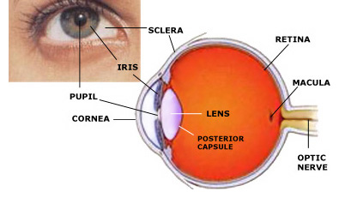
Eye Pressure & its affect on vision
The high eye pressure also known as the intraocular pressure increases when the flowing fluid inside the eye, also known as the aqueous humor builds up instead of draining out.
The aqueous humor usually drains through the tissue called trabecular meshwork which is located at the angle where iris and cornea of the eyes meet.
The optic nerve is located at the back of each eye and connects directly to the brain. The optic nerve contains millions of nerve fibers that send visual messages to the brain which enables vision.
The excessive aqueous humor in the eyes creates pressure and the high pressure inside the eyes damages the optic nerve and vision loss. This condition is known as glaucoma.
Figure 2: National Eye Institute: Eye pressure
Figure 3: Millennium Eye Center: Parts of the eye

Slide 4
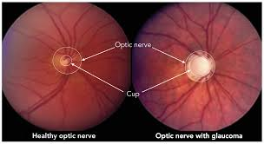
Common types of glaucoma & symptoms
Open-angle glaucoma:
No symptoms in early stage
Patchy blind spots in the side vision
Acute angle-closure glaucoma:
Eye redness, or severe eye pain
Blurred vision, or halos, or colored rings around light
Severe headache
Nausea or vomiting
Normal-tension glaucoma:
No symptoms in early stage
Blurred vision, and later loss of side vision
Glaucoma in children:
Increased blinking, cloudy/dull eye, tears without crying (symptoms in infants)
Headache
Nearsightedness gets worse
Figure 4: MDPI: Glaucoma

Slide 5
Diabetes & its affect on vision
The high blood sugar causes damages to the blood vessels and nerves run throughout the body, including eyes. The common diabetic eye condition is diabetic retinopathy which changes the retina’s blood vessels.
Either it causes leaking of the blood vessels or growth or abnormal new blood vessels. It can also lead to high eye pressure, glaucoma, or cataracts (a cloudy build up in the eye’s lens). It can also cause swelling in the eye lens and blurry vision
Figure 5: White Eye Center: Diabetic Retinopathy

Slide 6
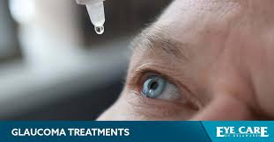
Treatments/Preventions for eye pressure & diabetes
Eye pressure:
Regular eye examination
Exercise safely
Limit caffeine
Optic nerve imaging
Diabetes:
Regular eye examination
Eat healthy foods
Exercise more
Check fasting blood sugar test
Figure 6: Eye Care of Delaware: Glaucoma treatment

Slide 7
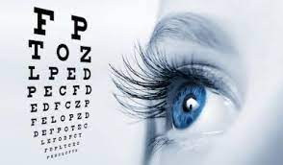
Discussion
It can be hard to figure out the eye pressure and diabetes, if we did not do a regular eye examination.
It is always good to find out earlier and applying treatments rather than waiting till the last minute which will result in vision loss. Also, controlling our intake of sugar rich food items is beneficial to avoid the accumulation of sugar In blood
Figure 6: Capital Women’s Care: Eye test

Slide 8
Work Cited
https://www.hopkinsmedicine.org/health/conditions-and-diseases/diabetes-and-your-eyes-what-you-need-to-know
https://www.mayoclinic.org/diseases-conditions/glaucoma/symptoms-causes/syc-20372839https://www.mayoclinic.org/diseases-conditions/glaucoma/symptoms-causes/syc-20372839
https://eyetique.com/what-causes-high-eye-pressure-and-how-to-reduce-it
https://www.nei.nih.gov/learn-about-eye-health/eye-conditions-and-diseases/glaucoma/glaucoma-and-eye-pressure
https://www.aao.org/eye-health/anatomy/parts-of-eye
https://www.mayoclinic.org/diseases-conditions/diabetes/symptoms-causes/syc-20371444#:~:text=The%20exact%20cause%20of%20most,of%20genetic%20or%20environmental%20factors.
https://www.cdc.gov/diabetes/basics/getting-tested.html
https://www.google.com/search?q=eye+health&sxsrf=AJOqlzUxge6QHX8Kn93N4nvs7udpoPC5eg:1677374756324&source=lnms&tbm=isch&sa=X&ved=2ahUKEwjqvIX0g7L9AhXkjIkEHfFaDF0Q_AUoAXoECAEQAw&biw=1536&bih=746&dpr=1.25#imgrc=JvaAD61Yu1ex9M
https://www.mayoclinic.org/
https://www.aoa.org/healthy-eyes/eye-and-vision-conditions/glaucoma?sso=y
https://www.healthline.com/health/glaucoma
https://www.cdc.gov/visionhealth/resources/features/glaucoma-awareness.html
https://glaucoma.org/
https://www.pennmedicine.org/for-patients-and-visitors/patient-information/conditions-treated-a-to-z/glaucoma
https://www.aoa.org/healthy-eyes/eye-and-vision-conditions/diabetic-retinopathy?sso=y
https://www.cdc.gov/diabetes/managing/diabetes-vision-loss.html
https://medlineplus.gov/diabeticeyeproblems.html

